Slide 1
SOCIAL MEDIA ANALYTICS HOME WORK -5
BY Ravinthiran Partheepan

Slide 2
Query
Make community network from dataset assgn5.csv. Use Walktrap algorithm.
Visualize the network

Slide 3
Technical Aspects
Programming Language Used R Script
Library Used igraph,VisNetwork

Slide 4
Solution For the Query
I have assigned a variable ‘ravi1407’ and embedded the dataset with that variable.
Then with the help of igraph library, I have generated a walktrap community with the calling function‘Walktrap.community(ravi1407)’
‘Walktrap.community()’ this function tries to find densely connectd subgraphs, also called communites in a graph via random walks. The short random walks stays in same community.
After the Community implemention, I have crafted a %du% full_graph(333). Becuase the node variable holds a bigger interger value for that I have implied %double% type.
Then with the help of VisNetwork library, I have Visualized the Network <- VisNetwork(ravi1407) .

Slide 5
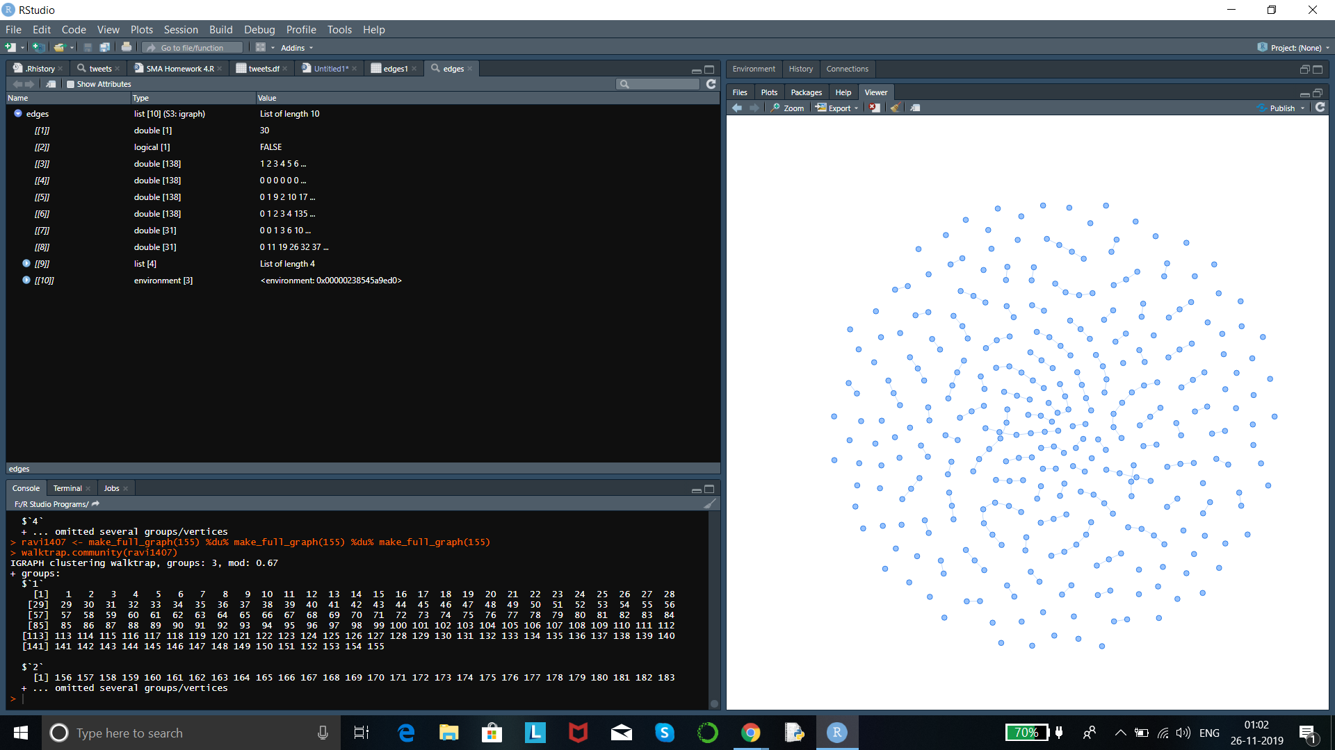
Program Code

Slide 6
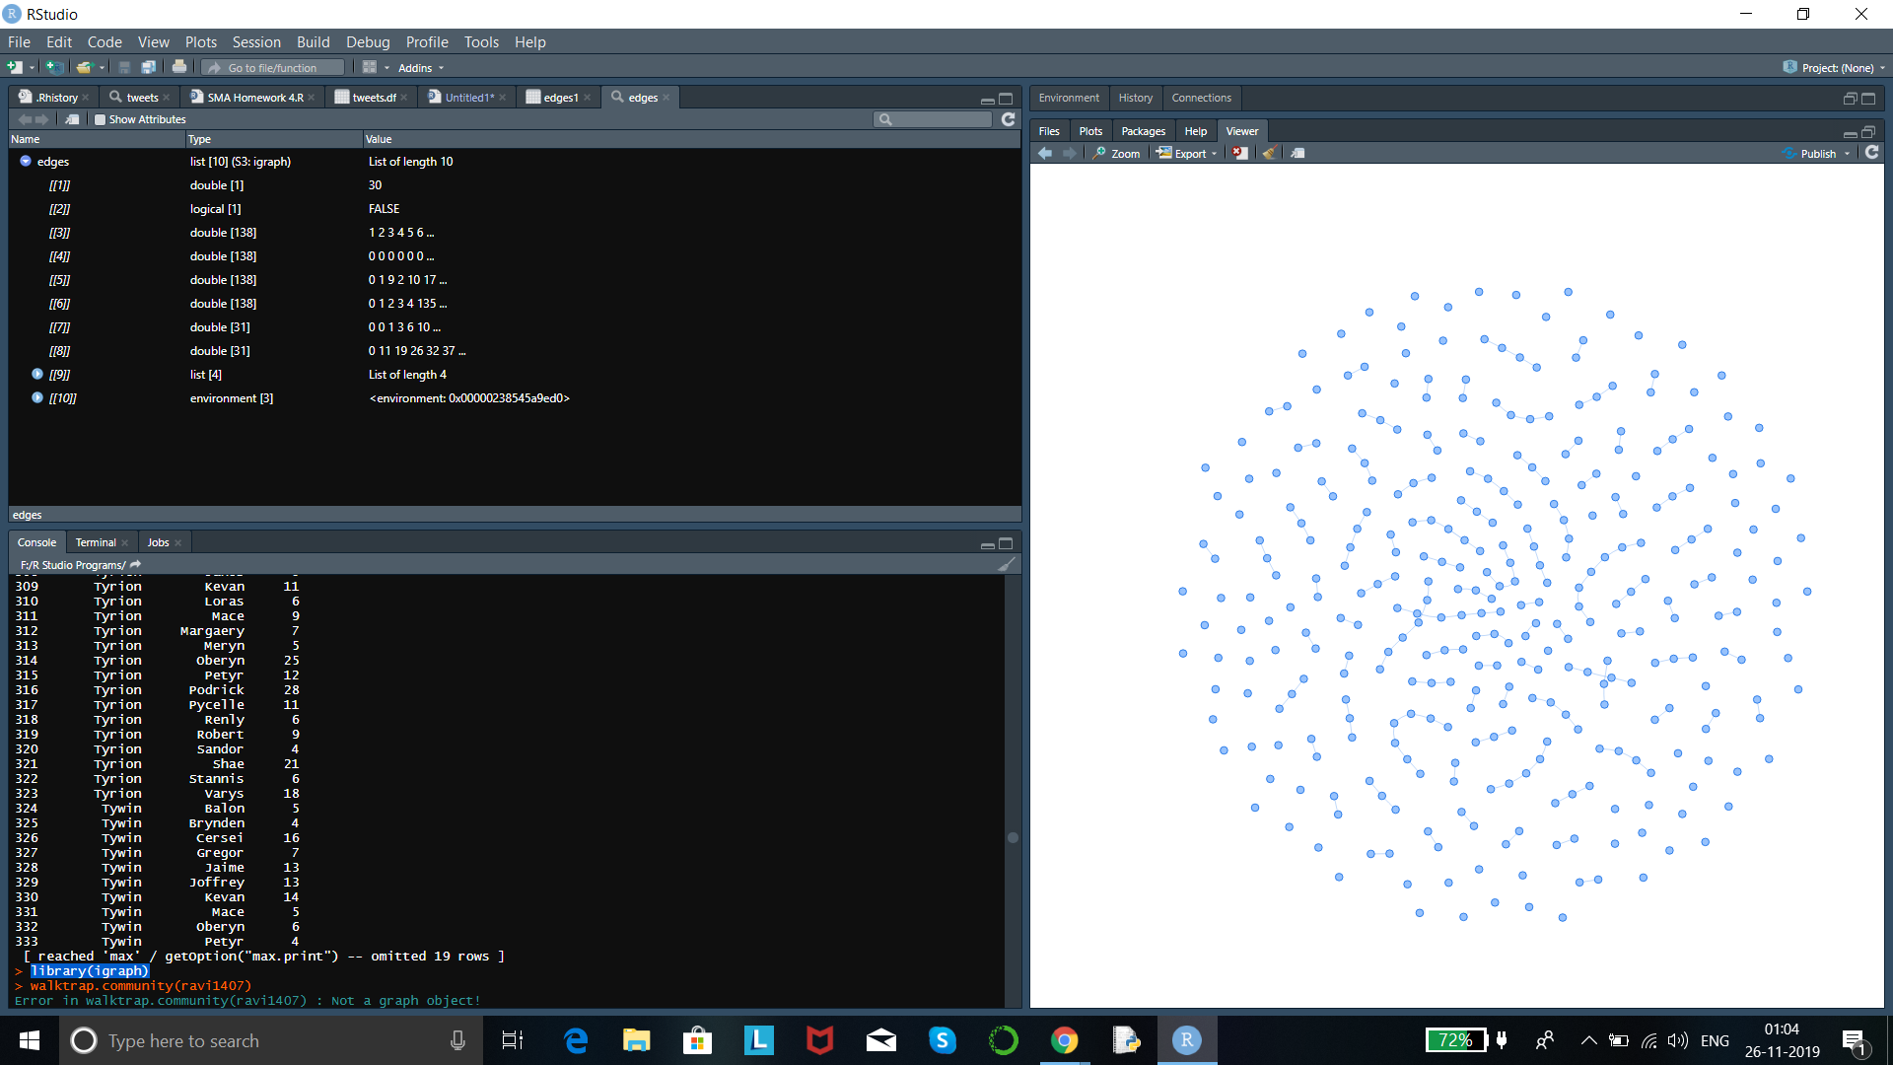
Program Code

Slide 7
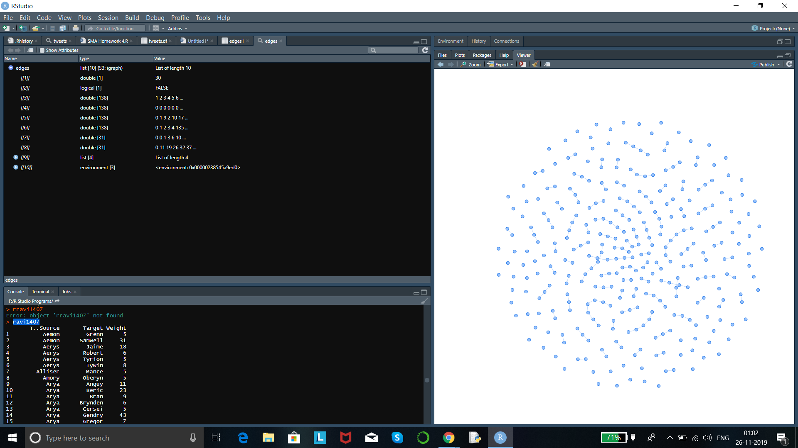
Program Code

Slide 8
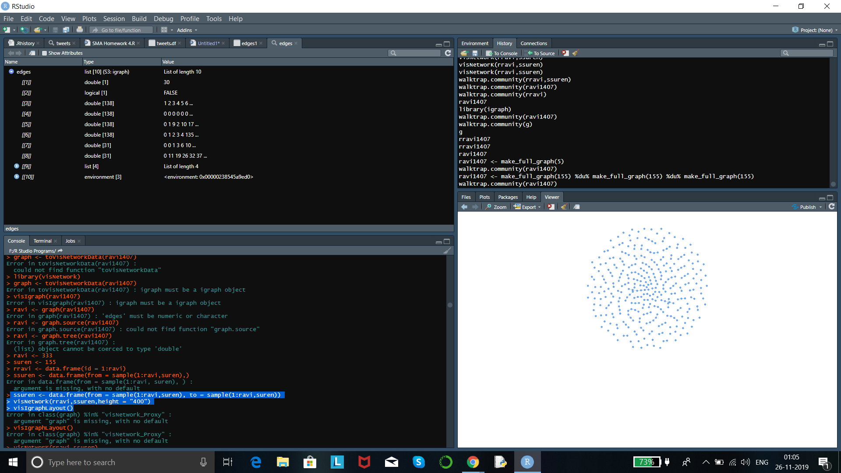
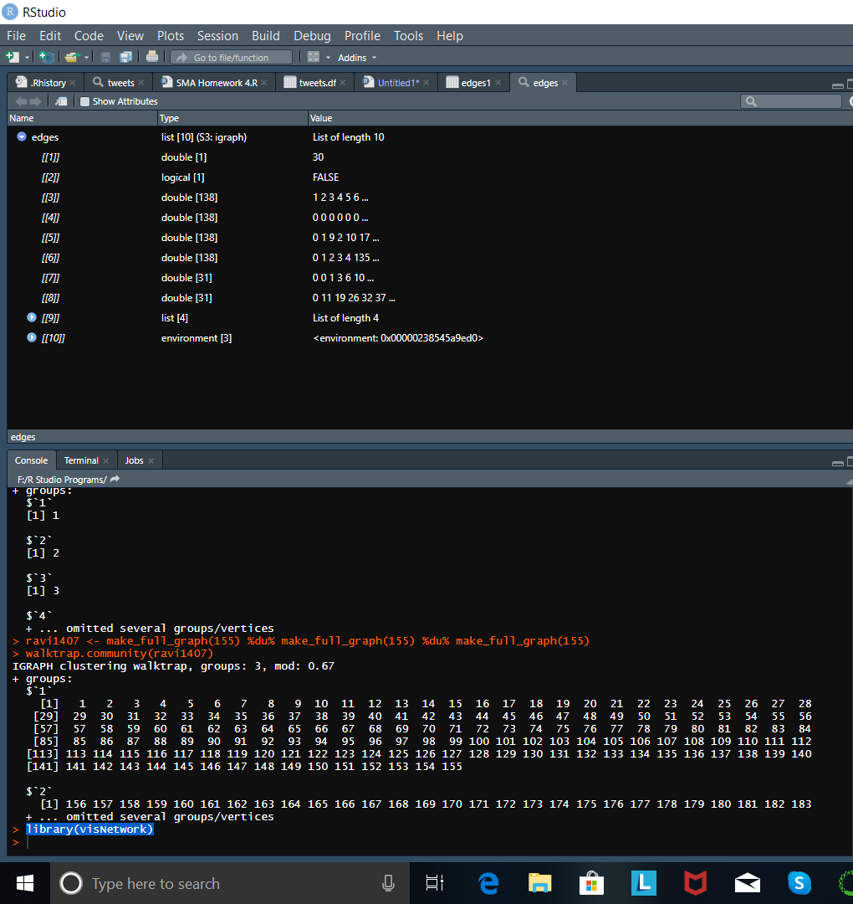
Program Code

Slide 9
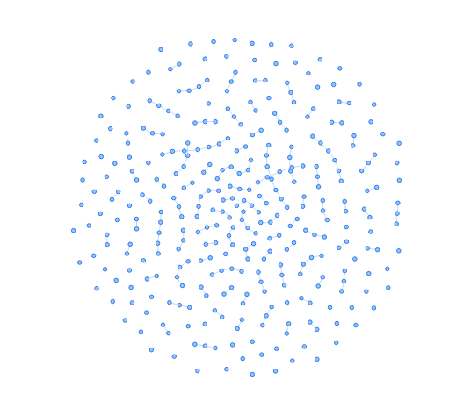
Output:-

Slide 10
Thank You!

